Slide 1
Encapsulation in Python
DVT101 – Lecture 40
- By Dataverse Tutorials

Slide 2
What is Encapsulation in Python?
Meaning of encapsulation in OOP
Data hiding concept
Controlled access to class data
Relationship with class design

Slide 3
Why Encapsulation Matters
Protects sensitive data
Prevents accidental data modification
Improves code reliability
Makes systems secure

Slide 4
Real-World Analogy of Encapsulation
Bank account balance access
ATM interface vs backend logic
User actions vs internal processing
Controlled interaction model

Slide 5
Encapsulation in Object-Oriented Programming
Binding data and methods together
Separation of interface and implementation
Reduced system complexity
Cleaner architecture

Slide 6
Public vs Hidden Data
What data should be exposed
What data should be hidden
Design decisions in classes
API-style class usage

Slide 7
Introduction to Access Specifiers
Purpose of access control
Visibility of class members
Naming conventions in Python
Logical access restriction

Slide 8
Types of Access Modifiers in Python
Public members
Protected members
Private members
Convention-based control

Slide 9
Public Members
Default access level
Direct accessibility
Use cases for public data
Risks of overexposure

Slide 10
Protected Members
Single underscore meaning
Intended internal usage
Subclass accessibility
Design discipline

Slide 11
Private Members
Double underscore usage
Name mangling idea
Strong data protection
Controlled access philosophy

Slide 12
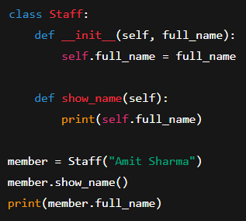
Program Concept: Public Members
Public attributes behavior
Public method accessibility
Object-based access
When to use public members

Slide 13
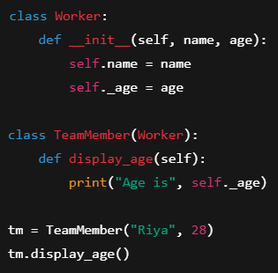
Program Concept: Protected Members
Protected attribute idea
Parent-child class interaction
Intended usage rules
Why Python trusts developers

Slide 14
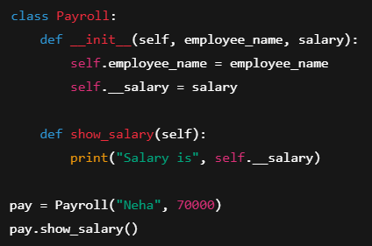
Program Concept: Private Members
Private attribute hiding
Internal access only
Error on direct access
Security-oriented design

Slide 15
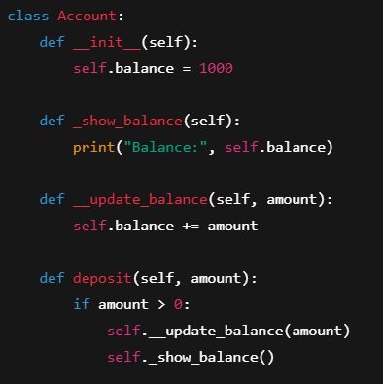
Protected vs Private Methods
Method-level encapsulation
Internal logic protection
Naming convention differences
Controlled workflow

Slide 16
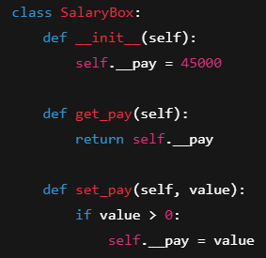
Getter and Setter Methods
Controlled data access
Validation during update
Read-only vs writable data
Encapsulation best practice

Slide 17
Summary & Key Takeaways
Encapsulation secures data
Access control improves design
Encourages disciplined coding
Essential for real-world software

Slide 18


